Slide 1





Exploratory Data Analysis (EDA) & Data Cleaning – Housing Price Dataset
Let's clean the dataset!
Prepared by : Suganthy
Date : 03/11/2025

Slide 2



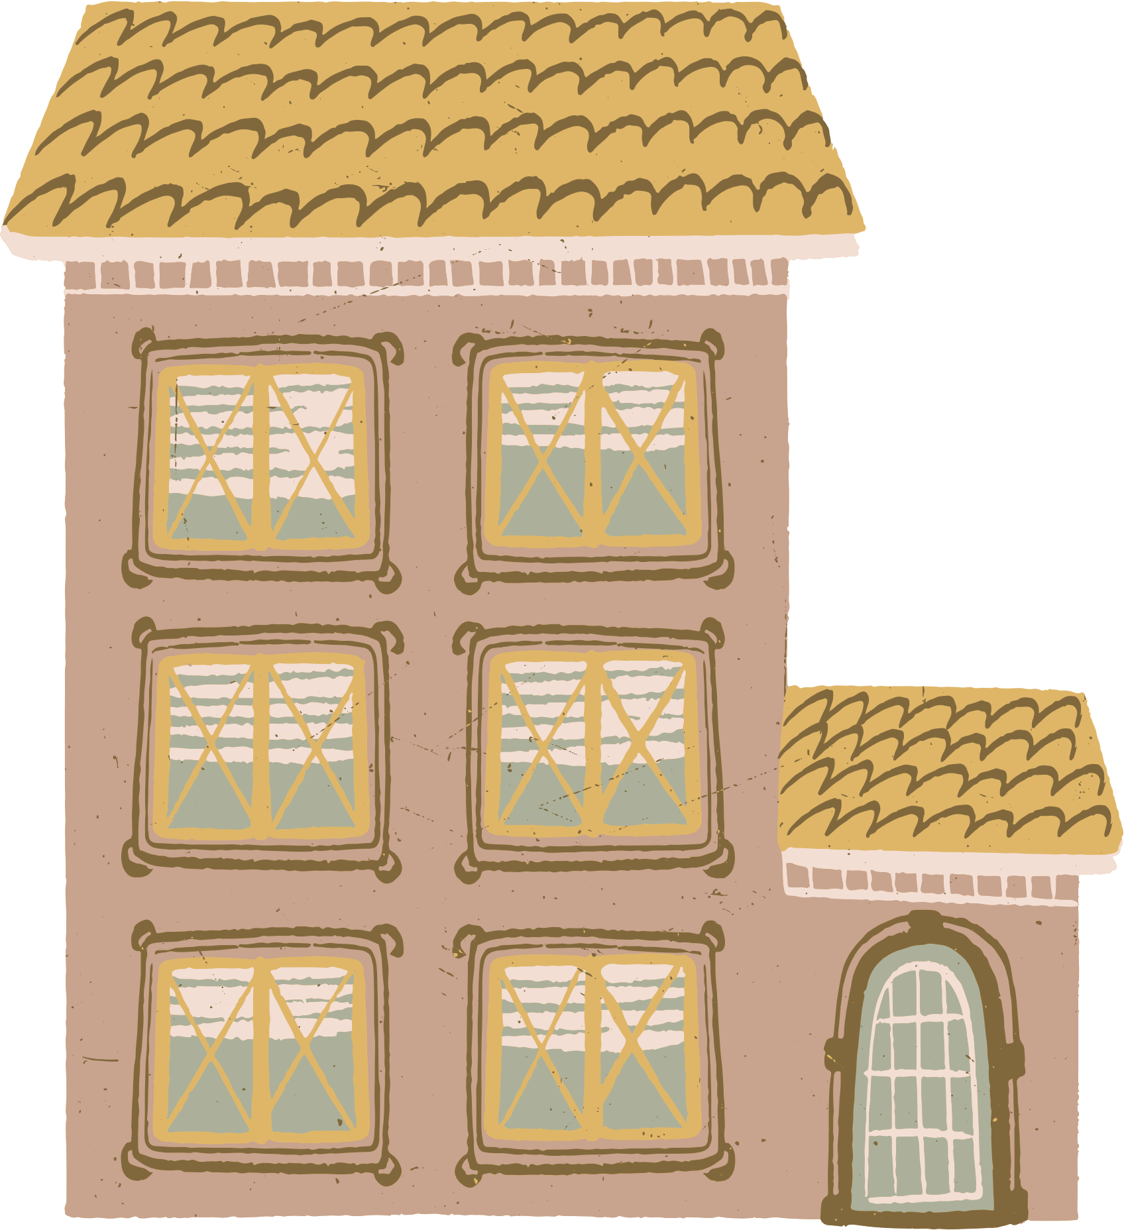
Project Objective & Deliverables
Objective | Deliverables
Perform Exploratory Data Analysis (EDA) and Initial Data Cleaning on housing data. | Cleaned CSV file
Prepare a clean, consistent, model-ready dataset for the modeling team. | EDA & Cleaning Report (with plots and justifications)

Slide 3


Dataset Overview
Total Records | 5,000 rows
Total Columns | 16
Target Variable | sold_price
Key Features | sqrt_ft, bedrooms, bathrooms, lot_acres, year_built, HOA
Categorical Variables | floor_covering, kitchen_features, fireplaces
Geographic Features | latitude, longitude

Slide 4
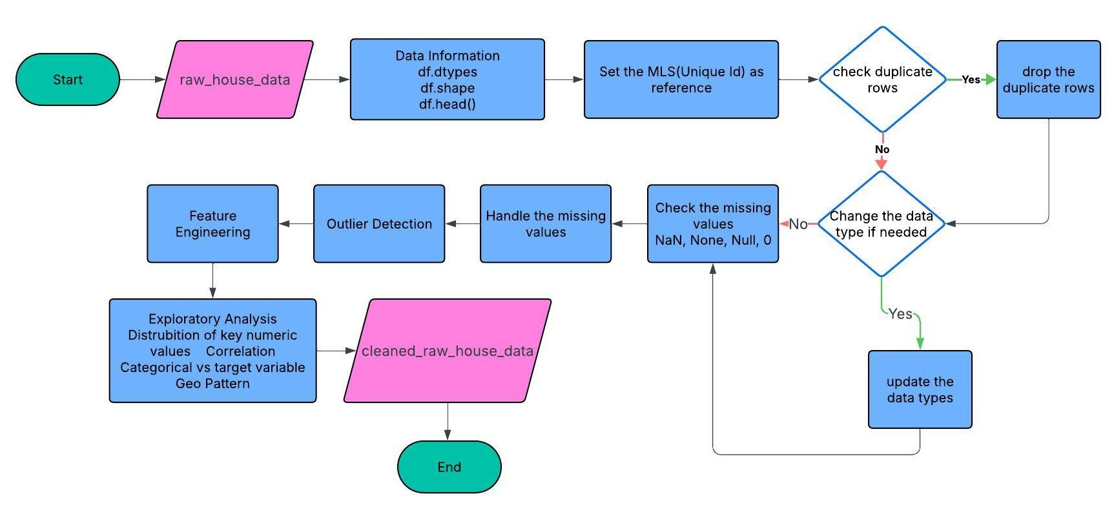
Flow Diagram

Slide 5
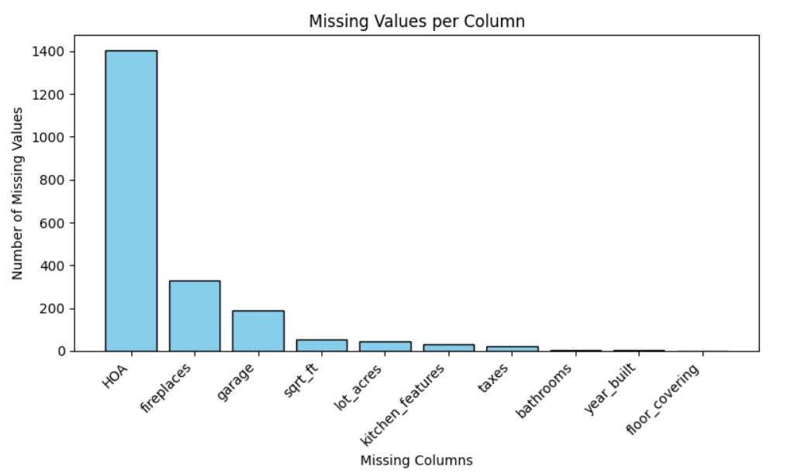

Missing Value Analysis
Numeric columns → replaced with median.
Categorical columns → replaced with ‘Unknown’.
Zeros treated as missing for specific numeric columns.

Slide 6
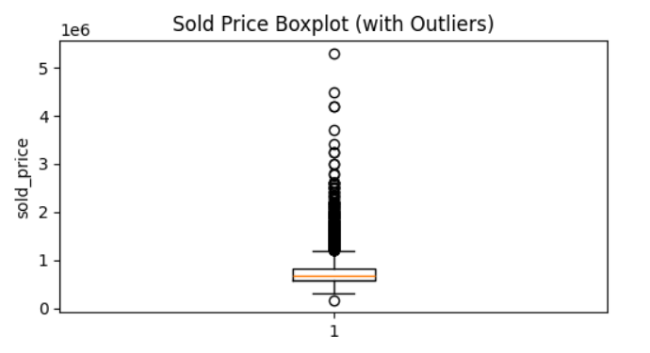
Outlier Detection
The boxplot shows how house prices are spread out, with most values close to the median. A few points above the upper line are outliers

Slide 7
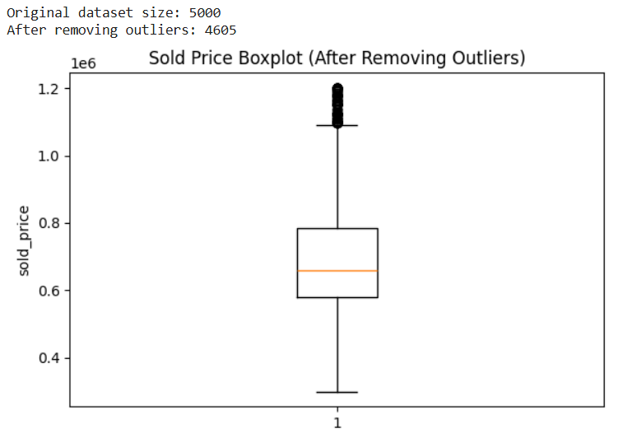
IQR Outlier Detection Formula
Lower Bound=Q1−1.5×IQR
Upper Bound=Q3+1.5×IQR
Any data point below the Lower Bound or above the Upper Bound is considered an outlier.

Slide 8
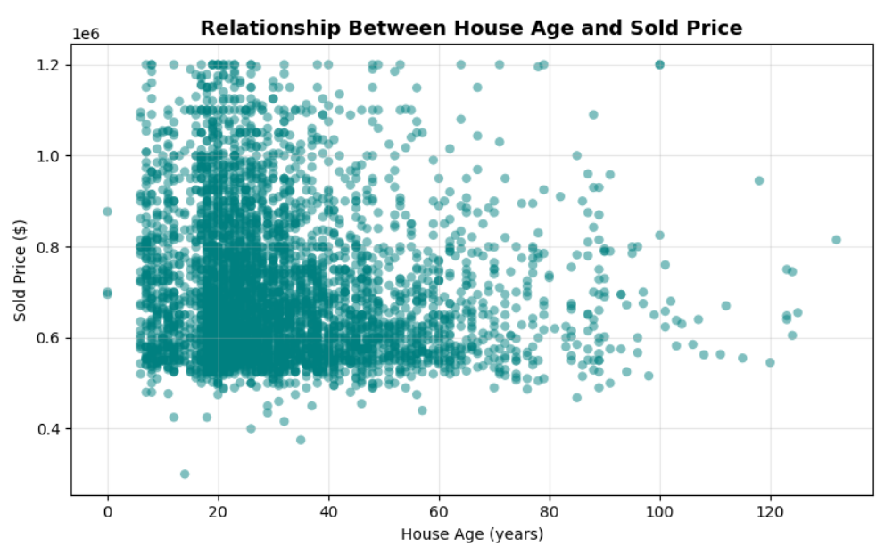
Feature Engineering
Process of creating or transforming columns to improve model learning.
Converts raw data → meaningful signals for better prediction.
Enhances data quality and captures real-world relationships.
In this dataset:
Price per Sq.Ft = sold_price / sqrt_ft
House Age = 2025 − year_built
Helps the model to understand, how different factors influence house price

Slide 9
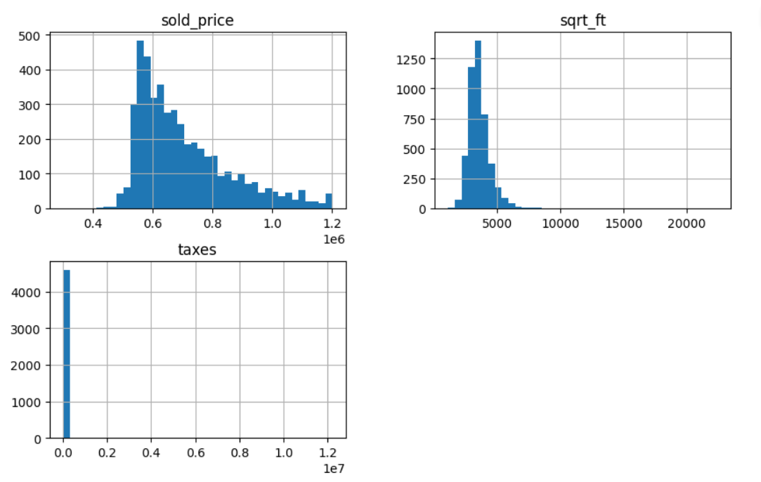
Exploratory Data Analysis
The histograms show the distribution of major numeric features — sold_price, sqrt_ft, and taxes.
Sold Price: Right-skewed distribution, meaning most homes sell within a lower price range while a few luxury properties drive higher values.
Square Footage: Also right-skewed, showing that most homes are mid-sized, with fewer very large houses.
Taxes: Highly concentrated near zero, indicating most properties fall under moderate tax brackets, with some extreme high-tax cases.
Overall, the data shows that housing prices and size follow a typical real-estate pattern and few premium listings
Distribution of Key Numeric Variables

Slide 10
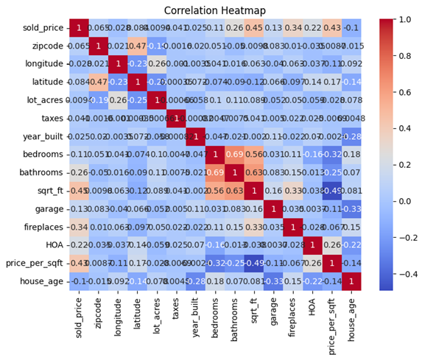

2. Correlation Heatmap
The heatmap shows how different features are correlated with each other and with sold_price.
sqrt_ft (0.45) and bathrooms (0.26) have strong positive correlations with sold price, larger homes with more bathrooms tend to sell for higher prices.
price_per_sqft (0.43) also shows a strong positive relationship, confirming its value as an engineered feature.
Lot_acres and HOA show weak correlations, indicating less impact on price.

Slide 11
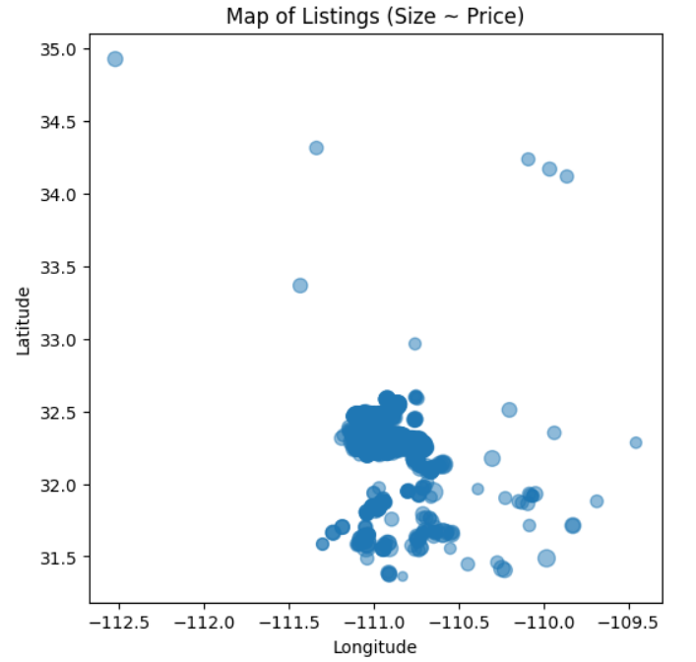
Geographical Price Insights
This scatter plot visualizes property locations based on latitude and longitude, with bubble size representing sold price.

Slide 12
Thank you!

